Slide 1
205SE Programming for Engineers
Tutorial 12
More Classes

Slide 2
Quick Recap on Last Week
Pointer Operators * and &
Using the const Keyword with Pointers
Using Pointers with Functions
Deitel Figures Chapter 8 from fig08_04 to fig08_14

Slide 3

Objectives for Today
More on classes
Pointers and objects
Arrays of objects
Vectors of objects
Class relationships:
Inheritance
Composition
Aggregation

Slide 4
Class initialiser lists
In the constructor we are creating an object and initialising some default values to its member variables
Initialiser lists provide a convenient way to set those member variables:
Student::Student(std::string n) :
name(n), grade('C')
{
// ctor body
}
Initialiser list

Slide 5

Activity 1
Write a Student class with a constructor and an initialisation list
A student should have a std::string for storing their name and a char for their grade
Test that the initialiser list works as expected by creating a talk method so the student can output their name and grade to the console

Slide 6
new and delete operators
Up to this point we have been using automatic (stack) storage for objects:
Student s1("Fred");
Now let's look at creating objects on the Heap:
Student *heapPtr = new Student("David");
Whenever we create data on the heap using the new keyword we must remember to free up the memory afterwards with the delete keyword:
delete heapPtr;
Fred is stored automatically
David is stored on the heap

Slide 7
Pointers and objects
Before we can call any of the methods of the object we are pointing to we must dereference the pointer
We can do a dereference and call all in one go by using the arrow syntax for calling members:
heapPtr->setGrade('A');
heapPtr->talk();
Dereference and call all-in-one

Slide 8
Activity 2
Create a student object on the heap by using the new keyword.
Try calling methods of the student object by using the arrow syntax (dereference and call).
Finally use the delete keyword do free up the memory again and avoid any memory leaks.

Slide 9
Arrays of objects
In a similar manner to creating an array of primitive types we can create and array of objects.
An array of objects defined locally without an initialiser list will call the default constructor for each object in the array.
If a default constructor does not exist then the programmer must include an initializer list for each of the constructor calls e.g.
Student group[3] = { Student("Bob"),
Student("Sue"), Student("Rob") };

Slide 10
Activity 3
Create an array which contains 3 student objects.
Use an initialiser list for student names.
Write a for loop to set grades and test output.

Slide 11
Activity 4
The std::vector can also be used as a convenient way to store multiple objects.
Create a std::vector which contains student objects. You can use the .push_back() method to add students to the vector one by one.
Again use a for loop to test the output.

Slide 12
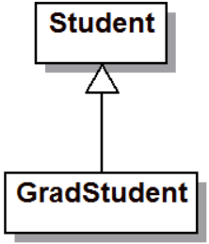
Inheritance
Inheritance is a relationship between two classes where a subclass is-a type of superclass e.g. GradStudent is-a type of Student and therefore should be able to do everything a Student can do
class GradStudent : public Student
{
}
Inherits from

Slide 13
Activity 5
Create a GradStudent class which inherits from the Student class
Create a GradStudent object and test that you can call the Student methods from the GradStudent object

Slide 14
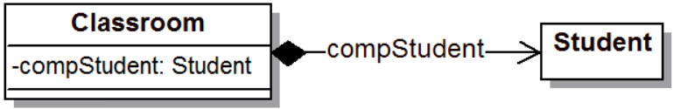
Composition
Composition is a relationship where an object is made up from other objects of different classes, e.g. a classroom object has-a student object.
When we create a classroom we must also create a student as part of that classroom.
Composition is achieved by creating an object inside a class as a class member variable.

Slide 15
Activity 6
Create a Classroom class which has-a student object as one of its class member variables.
Initialise the student object in the constructor initialiser list and set the grade in the constructor.
You can use the syntax to access the instance member variable:
this->compStudent.talk();

Slide 16
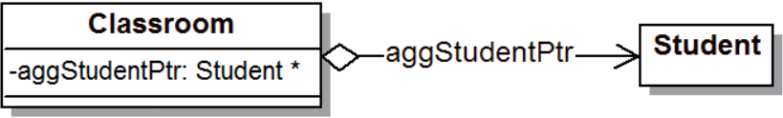
Aggregation
Aggregation is similar to composition but this time using a pointer to a student as a class member variable.
In this case we are saying a classroom could have a student as part of it.
With aggregation we can swap which student the pointer is pointing at and the student can have a lifetime outside of the classroom!

Slide 17
Activity 7
Add a pointer to a student inside of the Classroom as one of its class member variables.
Initialise the pointer to a student object using the new keyword in the constructor (just for testing).
You can use the syntax to access the instance member variable:
this->aggStudentPtr->talk();

Slide 18
Code for this week is on Moodle
Download the code ‘More with Classes’

Slide 19


CodinGame Activity 8

Slide 20
CodinGame Activity 8
Code Royale – Wood League:
https://www.codingame.com/multiplayer/bot-programming/code-royale
This one brings together multiple concepts we have learnt, but if you can create your own classes, use inheritance and use vectors of objects it really helps!
It is another ‘league-based’ style CodinGame.

